Slide 1



StoryVerse
Your Personalized Story App for Every Genre

Slide 2

Abstract
StoryVerse is a cutting-edge app designed to transform how users explore and discover compelling stories through movies and books. Tailored for avid story lovers, StoryVerse provides a unique platform that goes beyond traditional recommendations by allowing users to select their preferred genres or creatively mix two genres to uncover stories that match their exact tastes. Whether it’s the intrigue of a “mystery drama,” the excitement of a “sci-fi adventure,” or the charm of a “romantic fantasy,” StoryVerse delivers highly personalized suggestions that align with individual preferences.

Slide 3

Introduction
1
2
Modules
Algorithm
3
Contents
4
Flowchart
Implementation tools and technologies
5
6
Graphical User Interface
7
Conclusion
8
References

Slide 4



Introduction
StoryVerse is an innovative app designed to offer personalized recommendations for movies and books. By selecting genres of your interest, such as Action, Romance, or Sci-Fi, the app curates a list of must-watch movies and must-read books tailored to your preferences. Powered by the TMDB and Google Books APIs, StoryVerse transforms your entertainment search into a seamless and engaging experience. Dive into a world of stories and let StoryVerse guide you to your next favorite adventure!

Slide 5

1
React Native Framework
2
TMDB API
Modules
3
Google Books API
4
React Navigation
Deployment Platforms
5
Testing Tools
6

Slide 6


Algorithm
Step 1 : Planning and Design
Step 2 : Setup Development Environment
Step 3 : Implement Navigation
Step 4 : Add Splash Screen and Authentication
Step 5 : Build Core Features
Step 6 : Integrate APIs
Step 7 : Optimize User Experience
Step 8 : Test and Debug
Step 9 : Deploy and Release

Slide 7
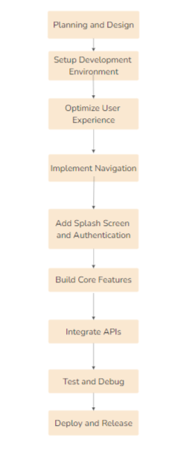
Flowchart

Slide 8

Implementation tools and technologies
Frameworks: React Native
Language: JavaScript
Navigation: React Navigation
API Integration: TMDB API, Google Books API
UI Design: React Native Paper, StyleSheet
Testing: React Native Testing Library
Development Tools: Android Studio

Slide 9
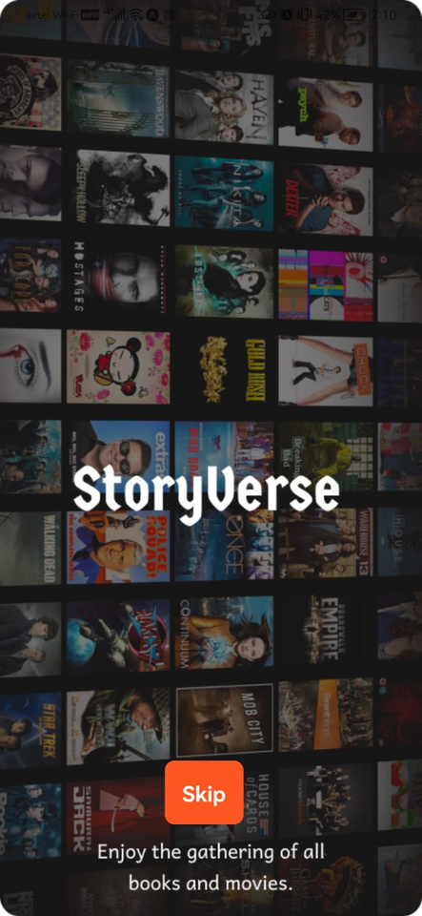
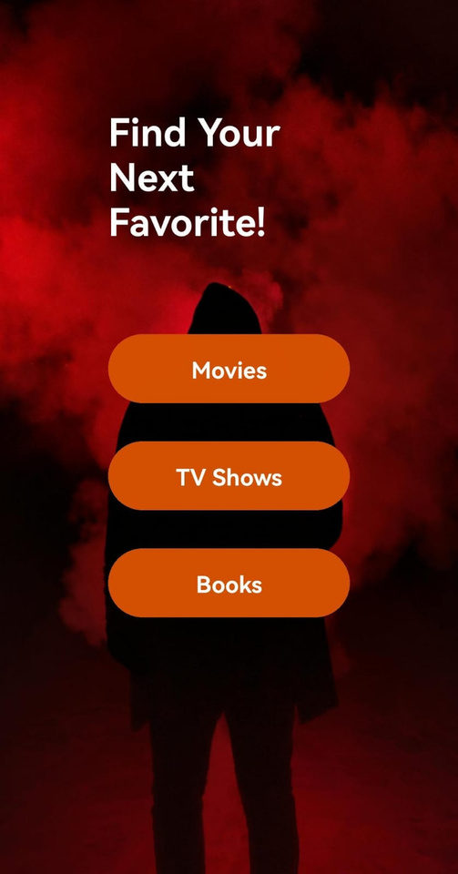
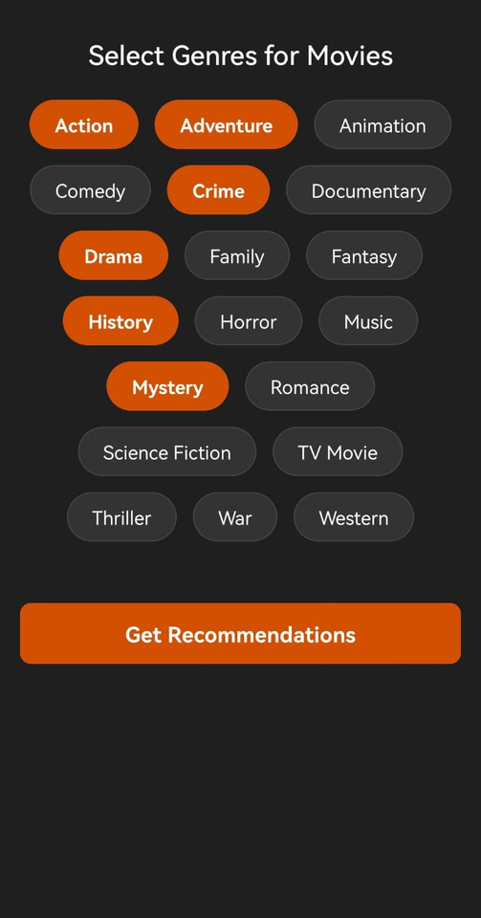
Graphical User Interface
Splash Screen
Home Screen
Genre Selection Screen

Slide 10
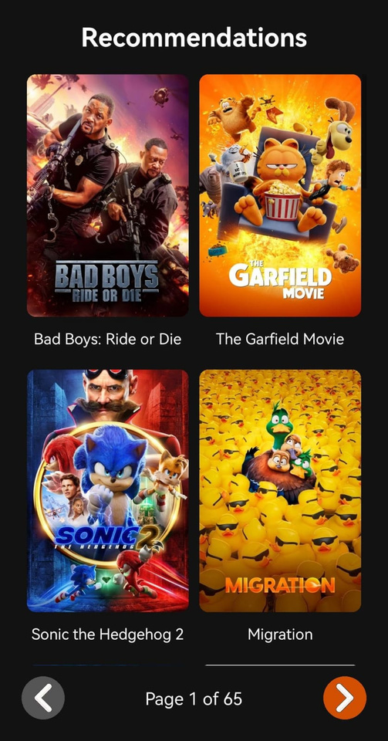
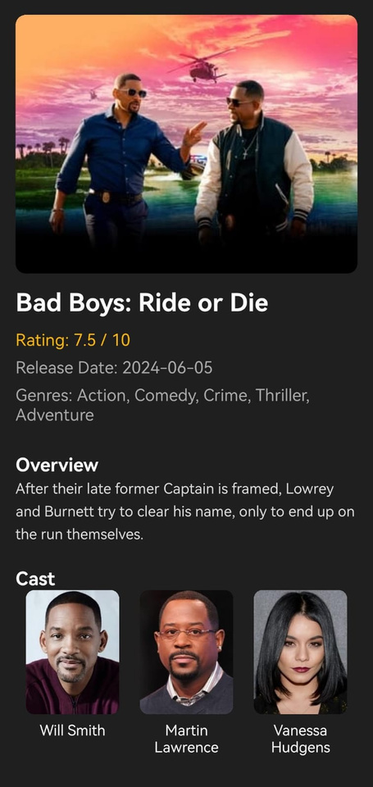
Graphical User Interface
Recommendation Screen
Movie Details Screen

Slide 11


Conclusion
StoryVerse is a dynamic app that seamlessly integrates movies and books into a personalized recommendation system based on user preferences. By leveraging powerful tools like React Native, Axios, and APIs like TMDB and Google Books, StoryVerse delivers a rich user experience with tailored content suggestions. With a focus on simplicity, performance, and ease of use, the app provides an engaging journey for users seeking entertainment, while maintaining the flexibility of cross-platform development and efficient deployment on both Android and

Slide 12
References
1. Jannach, D., & Adomavicius, G. (2016). Recommender Systems: Challenges and Research Opportunities. Springer. This book provides a comprehensive overview of recommender system algorithms and challenges, which are central to the StoryVerse app's book and movie recommendation features.
2.Schafer, J. B., Konstan, J. A., & Riedl, J. (2001). Recommender Systems: Challenges and Opportunities. Computer Science Department, University of Minnesota. A seminal paper in the field of recommender systems, it outlines key concepts and the various methods for generating personalized recommendations.
3.Zhang, Y., & Chen, L. (2019). Deep Learning for Recommender Systems: A Survey and New Perspectives. ACM Computing Surveys. Discusses deep learning approaches for recommendation systems, which could be used in StoryVerse to enhance content suggestion accuracy.
4.Vasconcelos, F., & Santos, J. (2018). User-Centric Mobile Application Development: Approaches and Best Practices. Springer. Explores best practices and methodologies for developing mobile applications with a focus on user experience and interaction, relevant to StoryVerse’s mobile platform.

Slide 13
Thank you!
Any Queries..
Team Members:
Mustafa Mohammed Meraj - 160722733076
Mir Ayan Ali - 160722733083
Ayman Uzayr - 160722733086
Under the guidance of
Mr. T . Srikara Shobith
Assistant Professor
Department of CSE

